Slide 1

Module 1: Computer Programming Languages
CPRG 216: Object-Oriented Programming 1

Slide 2
Objectives
Describe what computers do
Define a programming language
Illustrate the evolvement of programming languages
Describe how the computer interprets algorithm
Explain the flow of control of programs
Compare programming languages
Describe Python and its characteristics

Slide 3
What is a computer?
A programmable electronic device that performs various tasks and manipulates data:
It stores and retrieves data/information
It processes data (e.g., performs arithmetic and logical calculations, executes instructions)
Computer has hardware and software
Hardware: Physical components as CPU, RAM, etc.
Software: set of programs, associated data, and documentation used to perform specific tasks

Slide 4
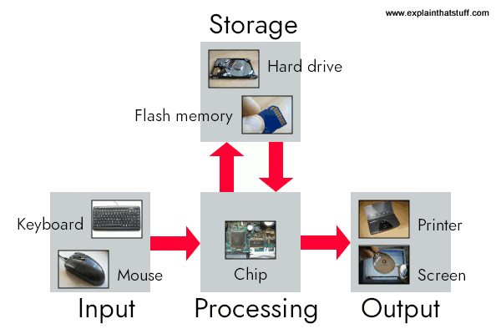
Computer Hardware
Input: Your keyboard and mouse, for example, are just input units—ways of getting information into your computer that it can process.
Memory/storage: Your computer probably stores all your documents and files on a hard drive.
Processing: Your computer's processor (sometimes known as the central processing unit (CPU)) is a microchip buried deep inside. It works amazingly hard and gets incredibly hot in the process.
Output: Your computer probably has an LCD screen capable of displaying high-resolution (very detailed) graphics, and probably also stereo loudspeakers. You may have a printer.

Slide 5
Both the program and the data it manipulates reside in memory.
Typically, a program counter points to a particular location in memory, and computation starts by executing the instruction at that point.
Execution may jump to another point in the sequence of instructions. This is called flow of control, and is essential to allowing us to write programs that perform complex tasks.
Memory
Control Unit (program counter)
Arithmetic logic Unit (operations)
Input
Output

Slide 6
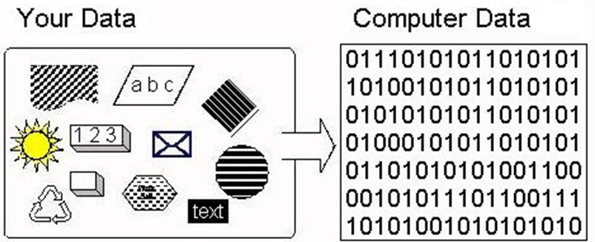
Data Storage – Binary System
Data are encoded as a series of bits (zeros and ones).

Slide 7
Computer Software
Programs written by a programming languages
2 main types
Operating Systems | Hardware manager Windows, Linux, Mac OS, Unix, etc.
Applications | Makes computer useful Helps users in their life and working environment MS-Word, Excel, Games, etc.

Slide 8
Computer Software
Program | A set of code and instructions that tells a computer how to perform, run and execute specific tasks to solve a specific problem. Implemented by a programmer or developer using a programming language
Programming | The process of writing programs
Programming Language | The language used to implement programs It includes set of notations, rules/syntax, statements, and keywords

Slide 9
Programming language
Writing recipes, programs, or sequences of instructions requires a programming language
A way to tell the computer exactly what to do , it will do it perfectly every time we run the program ... even if what we told it was wrong
Anything that can be programmed in one programming language (e.g., Python) can be programmed in any other programming language (e.g., Java).
Examples: Python, Java, C#, C++…

Slide 10
Programming language
Each programming language has:
a set of primitive constructs
a syntax
a static semantics
a semantics

Slide 11
Programming language & English
 | English | Programming language
primitive constructs | words | the literals(numbers, strings, +, / …)
syntax | describes which strings of words constitute well-formed sentences | describes which strings of characters and symbols are well formed (3.2 + 3.2 is right while 3.2 3.2 is wrong)
static semantics | defines which sentences are meaningful | defines which sentences are meaningful (3^2 and not Hi^2)
semantics | defines the meaning of those sentences. | defines the meaning of those sentences

Slide 12
Programming languages
Low-level versus high-level
General versus targeted to an application domain
Interpreted versus compiled

Slide 13
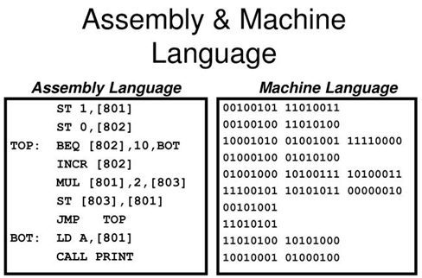
Low Level versus High Level Languages
Both are programming languages
Programmers can easily understand and use high-level languages because they use English like words
Low-level languages are machine friendly, faster, and memory efficient

Slide 14
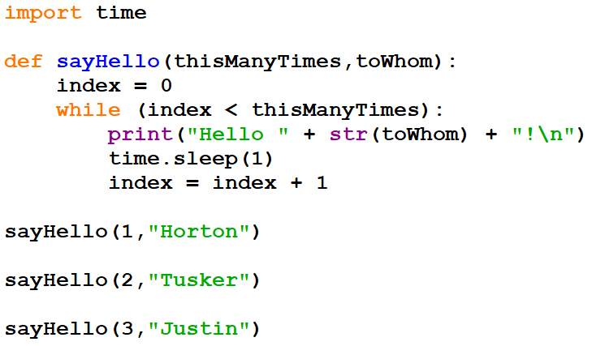
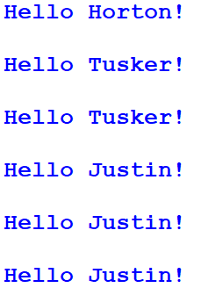
Low Level versus High Level Languages
Python Program
Output
Difference between High Level and Low level languages - GeeksforGeeks

Slide 15
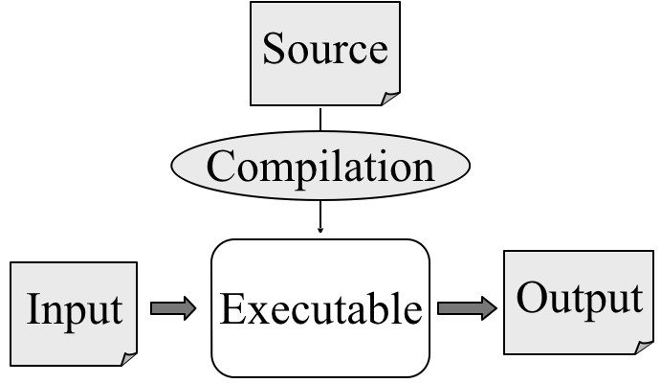
Complied Languages
These high-level programs can be changed to a lower-level computer language once (compiled), then the “compiled” executable can run many times
Changing anything in the program after it is compiled requires re-compilation
These types of languages are called “Compiled languages”
https://lh3.googleusercontent.com/BbsWt1hxsm-_3maVS97IlSmf82nnhYcd94X2Kcq-Gfypg-XahGwRDiCigVPm24v8qx7xecMrhKe99zgNwInr4XNQBtPmKxxRv8rExIr_ENQ962aY69dEMzN0lXdqcgNO1le1VoP0
Examples
Fortran, C, C++, …

Slide 16
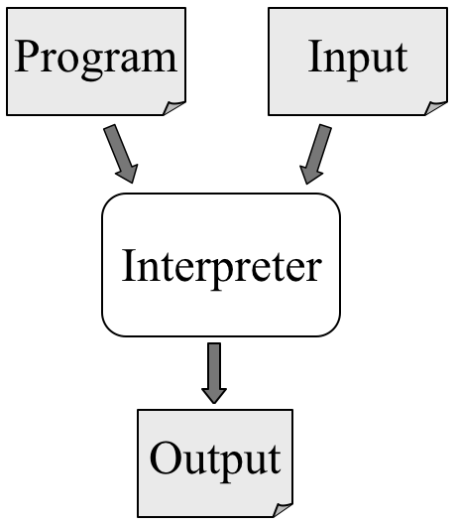
Interpreted languages
These high-level programs are “translated” line by line into the computer’s machine language every time they run
These types of languages are called “Interpreted languages”
Examples
Python, PERL, R, Javascript, Ruby, etc.
https://lh3.googleusercontent.com/BbsWt1hxsm-_3maVS97IlSmf82nnhYcd94X2Kcq-Gfypg-XahGwRDiCigVPm24v8qx7xecMrhKe99zgNwInr4XNQBtPmKxxRv8rExIr_ENQ962aY69dEMzN0lXdqcgNO1le1VoP0

Slide 17
Computer Programming errors
In computer programming there are two kinds of errors:
Syntax errors: mistakes in the code, such as spelling, incorrect label… which are relatively easy to find and fix: The compiler often identifies and alerts such errors
Logical errors: mistakes in the code steps/logic and result with incorrect or unexpected behavior. It can be difficult to find fix.

Slide 18
Python
General-purpose programming language | Simple to use | Used to build programs
An interpreted language, which can save you considerable time during program development | Very-high-level language | Allows you to split your program into modules
Enables programs to be written compactly and readably | Offers error checking | Extensible
Notes:
https://docs.python.org/3.10/tutorial/appetite.html
It is a relatively simple language that is easy to learn. Because Python is designed to be interpreted, it can provide the kind of runtime feedback that is especially helpful to novice programmers. A large and growing number of freely available libraries interface to Python and provide useful extended functionality.

Slide 19
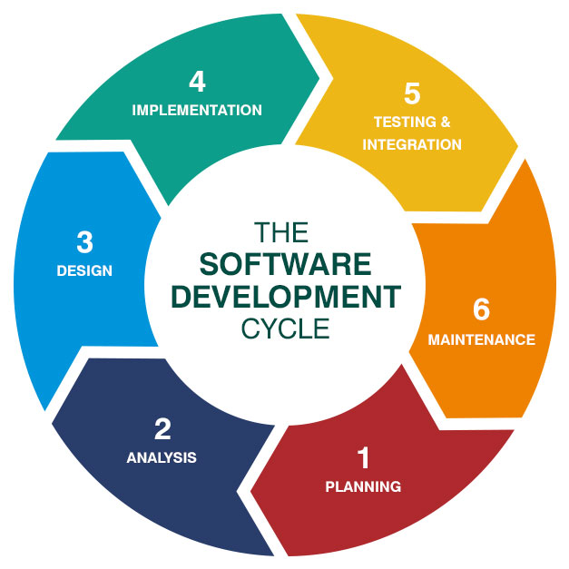
SDLC: Software Development Lifecycle
The process used by the development team to develop a high quality software system
Framework that defines software development tasks
It includes planning, analysis, design, implementation, testing, maintenance, and deployment activities
https://bigwater.consulting/2019/04/08/software-development-life-cycle-sdlc/

Slide 20
SDLC: Planning
The goal is planning for the software development project and conducting economical, operational and technical feasibility study to successfully develop a software system.
It also includes identifying potential risks associated with the project
In planning, the stages followed to develop the software system and associated outcomes or artifacts are also identified

Slide 21
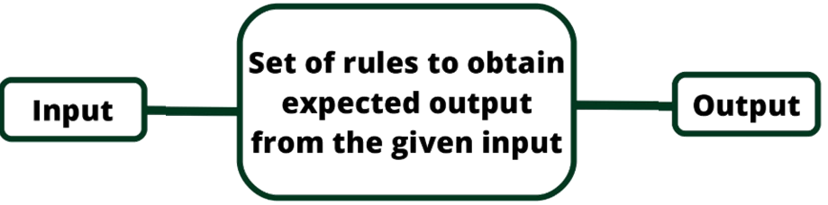
SDLC: Analysis
The goal is defining and documenting the functional and non-functional requirements of the software system.
It answers what is a problem/task for which the software system is developed.
In the course, the focus will be on identifying the required input, various processing, and the output.

Slide 22
SDLC: Design
The goal is defining the best architecture for the software system based on the requirements specification generated during the analysis.
It answers How is the software system developed to successfully solve the problem identified in the analysis.
In the course, the focus will be on using pseudo code and flowchart to represent the algorithm used to solve the given problem.

Slide 23
SDLC: Design - Algorithm
Algorithm is a set of steps used to solve a problem or perform a task
It is a flow of control process that specifies the start, order of the execution steps and the stop
It is independent on programming languages
It could be represented using pseudo code or flowchart

Slide 24
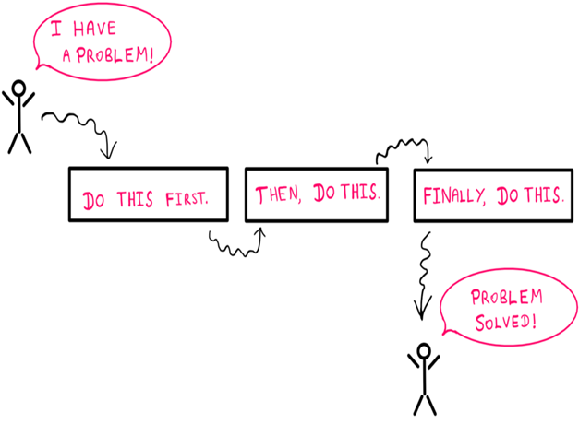
SDLC: Design - Algorithm
Algorithm should be:
Unambiguous – each step has precise instruction.​
Executable – must be possible for each step to be executable​
Terminating – each step must eventually come to an end.

Slide 25
SDLC: Design - Algorithm
Pseudocode | Flowchart
Textual detailed description of an algorithm Instructions are described using natural language It uses English like words | Graphical representation of an algorithm It is a diagram that represents workflow or process. It is a way to translate your ideas into more organized picture.
Both serve as a blueprint of the problem solution and will be converted into a program

Slide 26
SDLC: Design – Algorithm - Flowchart
Symbol | Purpose | Description
 | Flow Line | Indicates the flow of the logic by connecting symbols
 | Terminal (Start/Stop) | Represents the start and end of the flowchart
 | Input/Output | Use for input and output operations
 | Processing | Use for calculation and manipulation
 | Decision | Make decision between 2 or more options
 | Connector | Join different flow lines

Slide 27
SDLC: Design - Algorithm
Pseudo code and flowchart for calculating the circle area
Start
Get the radius of the circle
Calculate the circle area
Area = radius * radius * 3.14159
Display the circle area
Get Circle Radius
Area = radius*radius*3.14159
Display area
End

Slide 28
SDLC: Design - Algorithm
Pseudo code and flowchart for adding 2 numbers
Start
begin
Define Variables (Num1, Num2, Sum)
Ask the user to enter the first number
Get value for Num1
Ask the user to enter the second number
Get value for Num2
compute Sum as (Num1 + Num2)
display Sum
end
Define nNum1, nNum2, nSum
Get nNum1, nNum2
nSum = nNum1 + nNum2
Output nSum
End

Slide 29
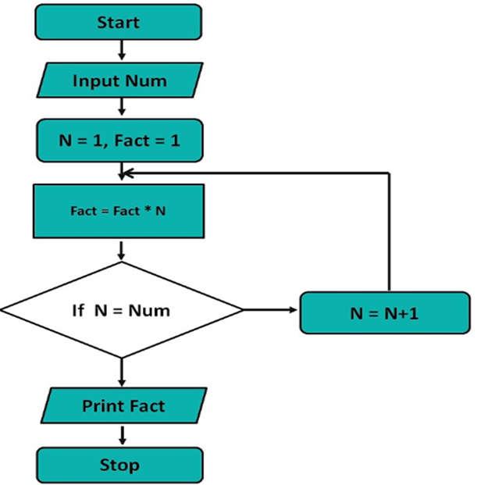
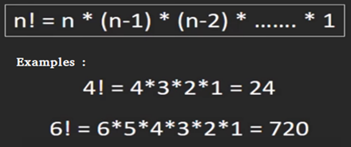
SDLC: Design - Algorithm
Flowchart for the factorial of a number.
No
Yes
How about Pseudo code?

Slide 30
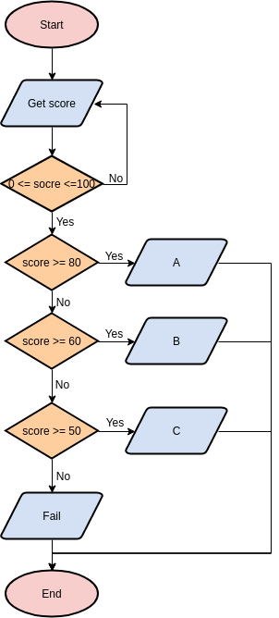
SDLC: Design - Algorithm
Flowchart for simple grading system

Slide 31
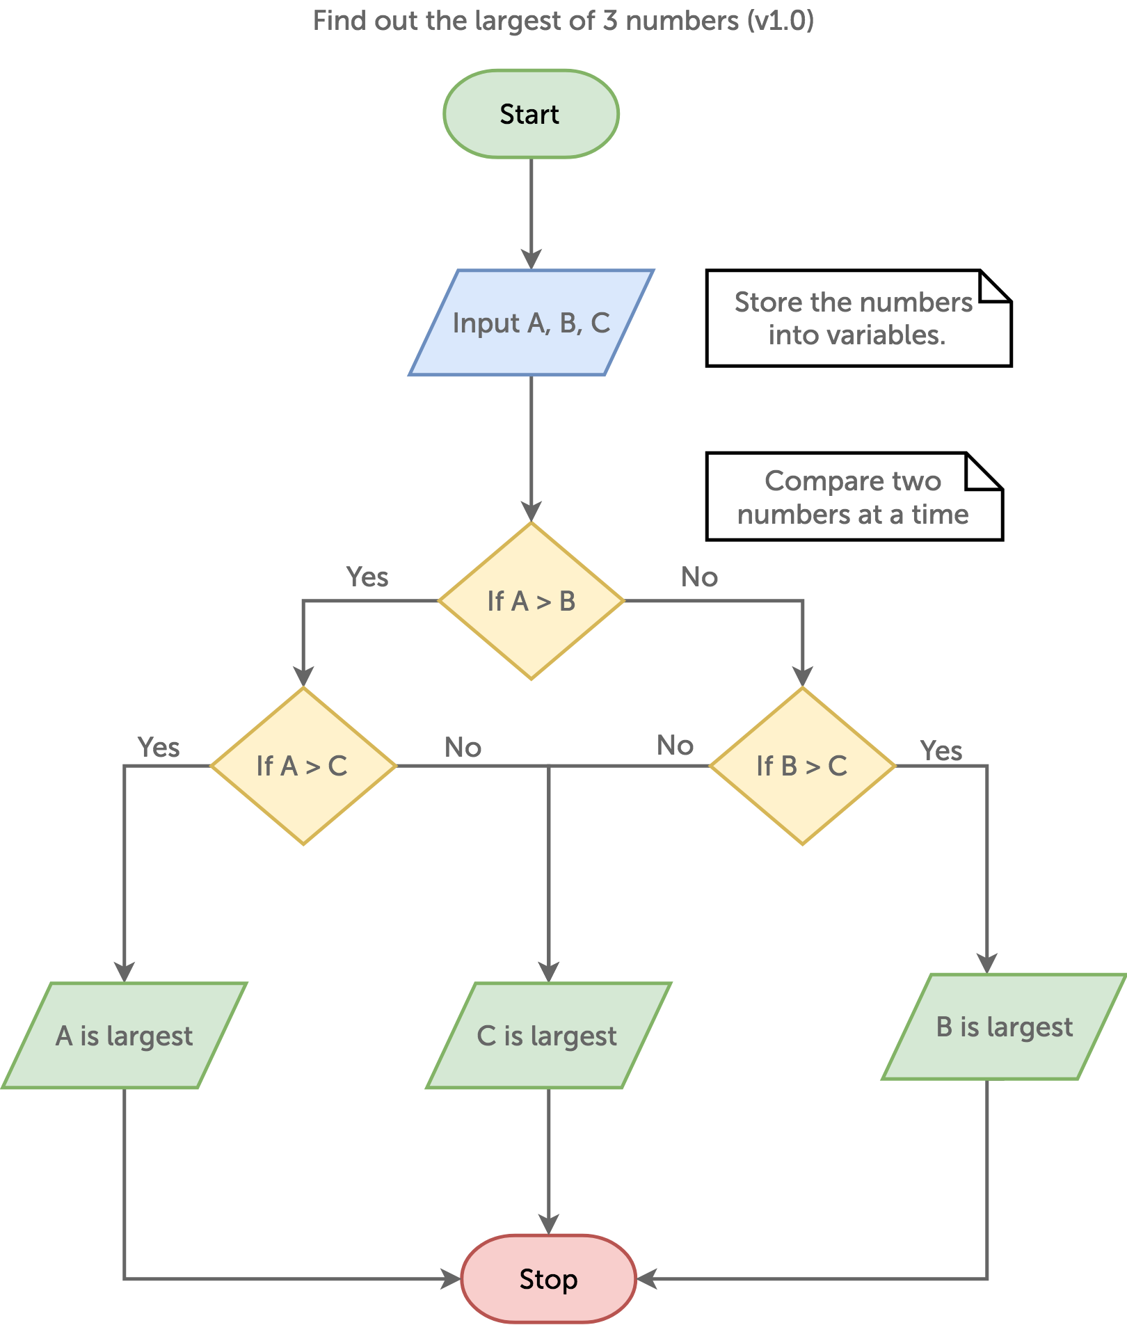
SDLC: Design - Algorithm
Flowchart for finding the largest among three different numbers entered by the user.

Slide 32
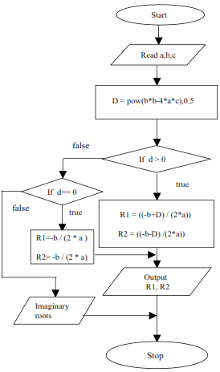
SDLC: Design - Algorithm
Flowchart for finding the roots of a quadratic equation

Slide 33
Exercise: Pizza Party Problem statement ​
A Company would like to sponsor a pizza party for you and your software development team. You decide to design an algorithm that will calculate the amount of pizzas and cost.​
Given the number of people attending a pizza party, output the number of needed pizzas and total cost. For the calculation, assume that people eat 2 slices on average and each pizza has 12 slices and costs $18.75. Round up the number of pizzas so that enough pizzas are ordered.​
Task: write the pseudocode for the problem specified above​
Notes:
https://www.csharp-console-examples.com/general/pseudocode-examples/

Slide 34
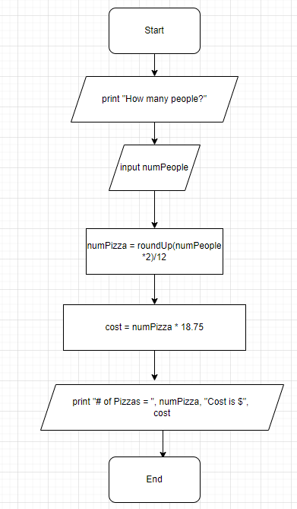
Exercise: Pizza Party Flowchart

Slide 35
Exercise: Pizza Party Pseudocode
print "How many people?"
input numPeople
numPizza = roundup(numPeople*2/12)
cost = numPizza * 18.75
print "#of Pizzas = ", numPizza, "Cost is $", cost

Slide 36
SDLC: Implementation
In this step, the software system is actually developed by writing the code using a programming language.
It is recommended to follow the coding standards and guidelines defined by the organization.
High-level programming languages as Python, Java, and C# are used

Slide 37
SDLC: Testing
The goal is ensuring that the developed software product meets the functional and non-functional requirements.
In testing, defects or errors are reported and fixed
The software product is then retested until reaching quality standards defined in the requirements specifications

Slide 38
Programming Process
Programs should be designed before they are written
Programming process:
Design the program.
Write the code.
Correct syntax errors.
Test the program.
Correct logic Errors.

Slide 39
SDLC: Deployment and Maintenance
The product is released to the market and used in workplaces
Customers report any issues and the software product is maintained by addressing the reported issues, adding new features, and modifying existing features

Slide 40
Integrated development environment (IDE)
A software application/suite that enables computer programmers develop computer programs.
Python IDEs provide
A text editor with syntax highlighting, auto completion, and smart indentation
A shell with syntax highlighting, and an integrated debugger

Slide 41
Install python and IDE
Download the latest version of python
Download pycharm IDE
Download VS code IDE

Slide 42
Lab
Computers can be annoyingly literal. If you don’t tell them exactly what you want them to do, they are likely to do the wrong thing.
Try writing an algorithm for driving between two destinations. Write it the way you would for a person, and then imagine what would happen if that another person follows your instructions (like a computer), and executed the algorithm exactly as written.
For an amusing illustration of this, take a look at the video https://www.youtube.com/watch?v=FN2RM-CHkuI&t=24s
Draw the flow chart of the algorithm

Slide 43
Reference(s)
https://docs.python.org/3.10/tutorial/index.html

